Slide 1
Design Presentation: Security
Owner: Sean Norman
CSA07P | 1 of 2
Session Day/Time: |  | Presenters/SMEs:
Virtual Format and Software:
Cohort / Breakout Mgmt
Objective of Session: | As a result of attending this, attendees will better be able to…
Existing Sources: | <link to any supporting content sources (if any)>
Learner Content: | <Link to draft ppt slide deck and any other materials that the attendees would be seeing or using as part of this session>
Presenter/ SME Guide Content: | <Link to any supporting materials that are just for the presenter and/or supporting SMEs>
Required Homework + name of session for HW review: | No homework or pre-required content needed for this session

Slide 2
Design Presentation: Security
Owner: Sean Norman
CSA07P | 2 of 2
Session Flow and Detailed Agenda |  | Presenter/SME: | Time
Prework | No attendee pre-work needed for this session | N/A | N/A
Session Introduction | Set context for when this process takes place | <presenter> | 3 mins
Body of the session / discussion, activities, Q&A... |  | <presenter> | 25 mins
Session Closing / Homework |  | <presenter> | 2 mins

Slide 3
Topics Covered
Security Secure a database in Azure Synapse
Advanced data security
Auditing
Network security
Authentication
Access control
Data protection

Slide 4
Security in Azure Synapse

Slide 5

Agenda
1 Security baseline
Synapse Analytics security baseline for Azure Security Benchmark
2 Network Security
Firewall rules, Managed Virtual Network and Managed private endpoints
3 Access control
Authorize database access to. Column and row-level security
4 Data Encryption
Set up Transparent data encryption.
Notes:
https://docs.microsoft.com/en-us/azure/synapse-analytics/security/synapse-workspace-ip-firewall
https://docs.microsoft.com/en-us/azure/synapse-analytics/security/synapse-workspace-managed-vnet
https://docs.microsoft.com/en-us/azure/azure-sql/database/transparent-data-encryption-tde-overview?toc=%2Fazure%2Fsynapse-analytics%2Ftoc.json&bc=%2Fazure%2Fsynapse-analytics%2Fbreadcrumb%2Ftoc.json&tabs=azure-portal

Slide 6
Security in Azure Synapse - Overview

Slide 7
Security overview in Azure Synapse
Connection security
Authentication
Authorization
Encryption

Slide 8
Advanced data security

Slide 9
Advanced data security
Data Discovery & Classification
Vulnerability Assessment
Advanced Threat Protection

Slide 10
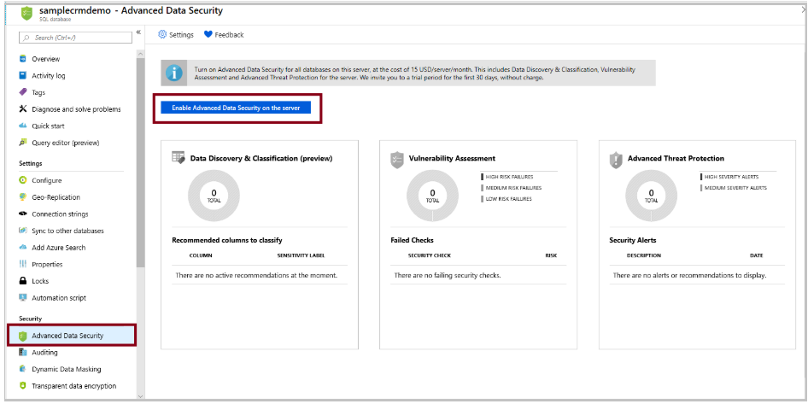
Enable ADS

Slide 11
Start classifying data, tracking vulnerabilities, and investigating threat alerts
Data Discovery & Classification card
Vulnerability Assessment card
Advanced Threat Protection card

Slide 12
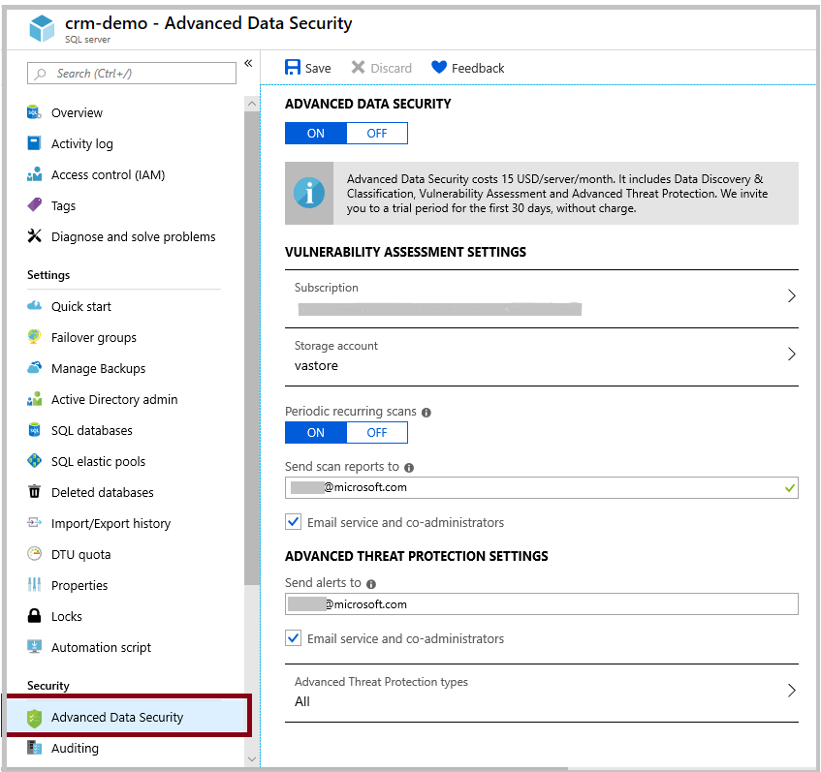
Manage ADS settings

Slide 13
Auditing

Slide 14
Auditing in Azure Synapse Analytics
You can use SQL Database auditing to:
Retain an audit trail of selected events
Report on database activity
Analyze reports
Auditing limitations
Premium storage is currently not supported.
Hierarchical namespace for Azure Data Lake Storage Gen2 storage account is currently not supported.
Enabling auditing on a paused Azure Synapse is not supported. To enable auditing, resume Azure Synapse.
Notes:
Add images

Slide 15
Set up auditing for your server
Audit to storage destination
Audit to Log Analytics destination
Audit to Event Hub destination

Slide 16
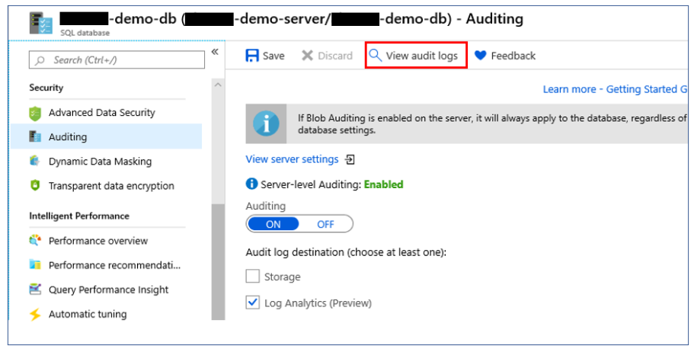
Analyze audit logs and reports

Slide 17
Production practices
Auditing geo-replicated databases
Storage key regeneration

Slide 18
Network Security
Notes:
Add slides on managed VNET’s
- One diagram for security

Slide 19
Azure Synapse IP firewall rules
How the firewall works
Server-level versus database level IP firewall rules
Permissions
Create and manage IP firewall rules

Slide 20
Private Link
Data exfiltration prevention
On-premises connectivity over private peering
Connecting from Azure Synapse Analytics to Azure Storage using Polybase

Slide 21
Virtual network service endpoints
Virtual network rules are one firewall security feature that controls whether the server for your databases and elastic pools in Azure SQL Database or for your databases in Azure Synapse accepts communications that are sent from particular subnets in virtual networks. This article explains why the virtual network rule feature is sometimes your best option for securely allowing communication to your database in Azure SQL Database and SQL Data Warehouse.

Slide 22
Access control

Slide 23
Authorize database access to SQL Database, SQL Managed Instance, and Azure Synapse Analytics

Slide 24
Column-level security

Slide 25
Row-level security

Slide 26
Data protection

Slide 27
Dynamic data masking
Dynamic data masking limits sensitive data exposure by masking it to non-privileged users.
Can be configured by the Azure SQL Database admin, server admin, or SQL Security Manager roles
Dynamic data masking policy: SQL users excluded from masking, Masking rules, Masking functions
Recommended fields to mask (check them in the DDM blade)

Slide 28
Set up dynamic data masking for your database using PowerShell cmdlets
Data masking policies
Get-AzSqlDatabaseDataMaskingPolicy
Set-AzSqlDatabaseDataMaskingPolicy
Data masking rules
Get-AzSqlDatabaseDataMaskingRule
New-AzSqlDatabaseDataMaskingRule
Remove-AzSqlDatabaseDataMaskingRule
Set-AzSqlDatabaseDataMaskingRule

Slide 29
Set up dynamic data masking for your database using the REST API
Data masking policies
Create Or Update
Get
Data masking rules
Create Or Update
List By Database

Slide 30
Thank You slide
Thank you

